Slide 1
Connect Four
Taylor Cummins
Andrea Conley

Slide 2
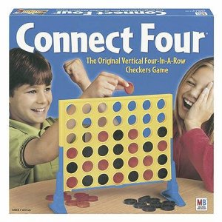
History
Published by Milton Bradley in 1974.
Ages 7 and up.
Also known as Captain’s Mistress, Four up, Plot Four, and Four in a row.

Slide 3
How to Play
2 player game
Each player picks a color then takes turns dropping the colored disks into the (7 column, six row, usually) grid.
The object of the game is to connect four disks in a row vertically, horizontally, or diagonally.

Slide 4
Connect Four Java Program
Two players alternating turns.
Players pick the column they want to place a token.
Program checks for column full
Program checks for four in a row. And announces the winner.
Search algorithms are optimized.

Slide 5
Code
So, when checking for a winner there are 4 different things to consider.
Vertical win
Horizontal win
Diagonal up win
Diagonal down win
boolean checkForWinner(char token){
//We have a winner if token appears 4 times in a row either vertically,
// horizontally, or diagonally
boolean win = false; //assume we have no winner yet
win = checkVertical(token); //check for 4 in a row vertically
if (!win) win = checkHorizontal(token); //check for 4 in a row horizontally if (!win) win = checkDiagonalUp(token); //check for 4 in a row '/'
if (!win) win = checkDiagonalDown(token); //check for 4 in a row '\'
return (win);
}

Slide 6
Analysis of Algorithms
In chapter two we learned different methods of making algorithms more efficient.
For example SequentialSearchRecursive is more efficient than SequentialSearch since it takes fewer operations to find the item. (section 2.6)
In the Connect Four object the checkForWinner methods stop searching when the match is found and they do not search the whole board due to the nature of Connect Four.

Slide 7
Improving Algorithm efficiency checkVertical
//Check for 4 tokens in a row vertically
boolean checkVertical(char token) {
boolean win=false; //Assume not a winner
int row, col; //row, column variables
for (col=0; col<7; col++) { //go through every column
if (topRow[col] <= 2) {//waste of time unless at least 4 rows have been used
for (row=0; row<=2; row++) {//4 vertical must include rows 0, 1, or 2
if (board[row][col] == token && //current row has token
board[row+1][col] == token && //1 row below has token
board[row+2][col] == token && //2 rows below has token
board[row+3][col] == token) { //3 rows below has token
win = true; //we have 4 in a row
return (win); //we have a winner
}
}
}
}
return (win);
}

Slide 8
checkHorizontal
//Check for 4 tokens in a row horizontally
boolean checkHorizontal(char token) {
boolean win=false; //Assume not a winner
int row, col; //Row,column variables
for (row=0; row<6; row++) { //Go through every row
for (col=0; col<=3; col++){//4 horizontal must include column 0, 1, 2, or 3
if (board[row][col] == token && //this column has token
board[row][col+1] == token && //column 1 to the right has token
board[row][col+2] == token && //column 2 to the right has token
board[row][col+3] == token) { //column 3 to the right has token
win = true; //we have 4 in a row
return (win); //we have a winner
}
}
}
return (win);
}

Slide 9
checkDiagonalDown
//Check for 4 tokens in a row diagonally down to the right
boolean checkDiagonalDown(char token) {
boolean win=false; //assume not a winner
int row, col; //row,column variables
//Check diagonal "\"
for (row=0; row<=2; row++) { //diagonal winner must include rows 0, 1, or 2
for (col=0; col<=3; col++) {//diagonal winner must include columns 0, 1, 2, or 3
if (board[row][col] == token && //this cell has token
board[row+1][col+1] == token && //cell one down, one right has token
board[row+2][col+2] == token && //cell two down, two right has token
board[row+3][col+3] == token) { //cell three down, three right has token
win = true; //we have 4 in a row
return (win); //we have a winner
}
}
}
return (win);
}

Slide 10
checkDiagonalUp
//Check for 4 tokens in a row diagonally down to the left
boolean checkDiagonalUp(char token) {
boolean win=false; //assume not a winner
int row, col; //row,column variables
//Check diagonal "/"
for (row=0; row<=2; row++) { //4 diagonal must include rows 0, 1, or 2
for (col=3; col<=6; col++){ //4 diagonal must include columns 3, 4, 5, or 6
if (board[row][col] == token && //this cell has token
board[row+1][col-1] == token && //one down, one left hast token
board[row+2][col-2] == token && //two down, two left has token
board[row+3][col-3] == token){ //three down, three left has token
win = true; //we have 4 in a row
return (win); //we have a winner
}
}
}
return (win);
}

Slide 11
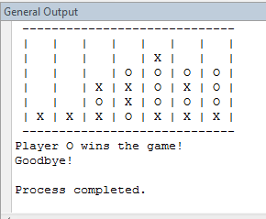
This is what the game looks like after one of the algorithms returns true. In this case it would be the checkHorizontal algorithm.

